Slide 1

Database Modeling
E/R Diagrams
Svetlin Nakov
National Academy for Software Development
academy.devbg.org

Slide 2

Contents
Modeling data – principles
Data types in SQL Server
Creating a new database SQL Server
Creating tables
Defining a primary key
Creating relations between the tables
Naming conventions

Slide 3
Relational Database Modeling
Fundamental Concepts

Slide 4
Steps in DB design
Identification of the entities
Identification of the columns in the tables
Defining a primary key for each entity table
Identification of relationships
  Multiplicity of relationships
Defining other constraints
Filling in test data

Slide 5
Identification of entities
Entity tables represent objects from the real world
  Most often they are nouns in the text of the specification
  For example:
  Entities: Student, Course, Town
We need to develop a system that stores information for students, which are lectured in various courses. The courses are held in different towns. When registering a new student the following information is entered: name, faculty number, photo and date.

Slide 6
Identification of the Columns
Columns in the tables are characteristics of the entities
  They have name and type
For example students have:
  Name (text)
  Faculty number (number)
  Photo (binary block)
  Date of enlistment (date)

Slide 7
Identification of the Columns
Columns are clarifications for the entities in the text of the specification, for example:
Students have the following characteristics:
  Name, faculty number, photo, date of enlistment and a list of all courses
We need to develop a system that stores information for students, which are lectured in various courses. The courses are held in different towns. When registering a new student the following information is entered name, faculty number, photo and date of enlistment.

Slide 8
How to Choose a Primary Key?
Always define an additional column for the primary key
  Don't use an existing column (for example SSN)
  Must be a number (integer)
  Must be declared as a primary key
  Use identity in SQL Server
  Put the primary key as a first column

Slide 9
Identification of relations
Relations are dependencies between the entities:
  "Students are lectured in various courses" – a many to many relation
  "Courses are held in towns" – a many to one relation
We need to develop a system that stores information for students, which are lectured in various courses. The courses are held in different towns. When registering a new student the following information is entered name, fac. number, photo and date of enlistment.

Slide 10
Data Types in SQL Server 2005

Slide 11
Data types in SQL Server 2005
Numeric
  bit (1-bit), integer (32-bit), bigint (64-bit)
  float, real, numeric(scale, precision)
  money – for money (precise) operations
String
  char(size) – fixed size string
  varchar(size) – variable size string
  nvarchar(size) – Unicode variable size string

Slide 12
Data types in SQL Server 2005
Binary data
  varbinary(size) – a sequence of bits
  image – a binary block up to 1 GB
Dates and times
  datetime – date and time starting from 1.1.1753 to 31.12. 9999 with a precision of 1/300 sec.
  smalldatetime – date that is precise to the minute

Slide 13
Data types in SQL Server 2005
Other
  timestamp – automatically generated number whenever a change is made to the data

Slide 14
Data types in SQL Server 2005
Nullable and NOT NULL types
  All types in SQL Server may or may
  not allow NULL values
Primary key columns
  Define the primary key
Identity columns
  Automatically increased values when a new row is added (autoincrement)
  Used in combination with primary key

Slide 15
Database Modeling with SQL Server Management Studio
Database Creation

Slide 16
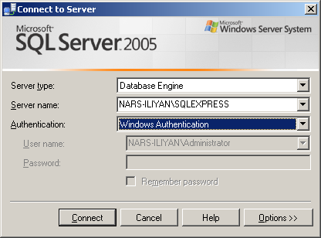
Connecting to SQL Server
When starting SSMSE a window pops up
Usually it is enough to just click the "Connect" button without changing anything

Slide 17
Connecting to SQL Server
If we want to connect to a server in the local network, we have to select the name of the server from the dropdown menu Server Name
Authentication – leave the default value: Windows Authentication

Slide 18
Working with Object Explorer
Object Explorer is the main tool to use when working with the database and its objects
Enables us:
  To create a new database
  To create objects in the database (tables, stored procedures, relations and others)
  To change the properties of objects
  To enter records into the tables

Slide 19
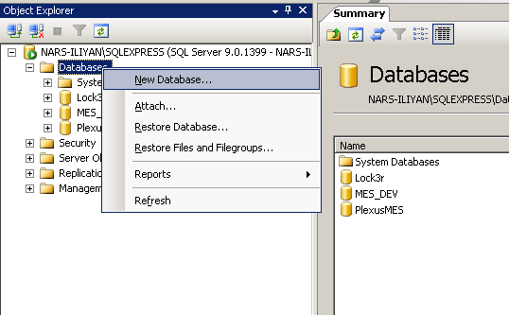
Creating a new database
In Object Explorer we go to the Databases level and choose "New Database" from the context menu

Slide 20
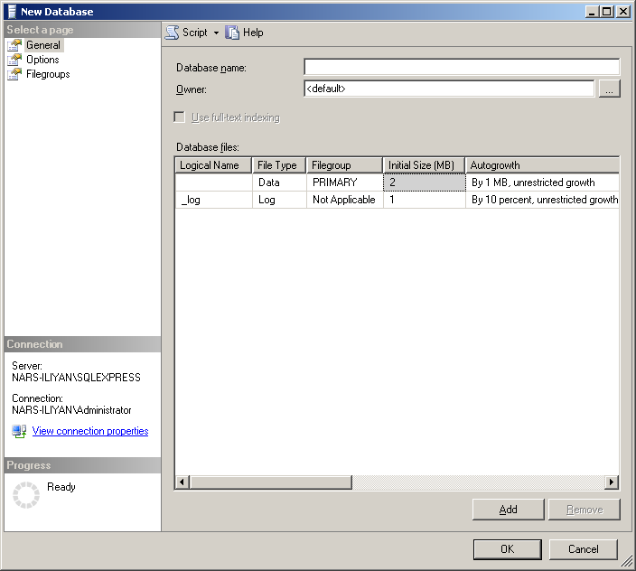
Creating a new database
In the "New Database" window we enter the name of the new database and click OK

Slide 21
Database Modeling with SQL Server Management Studio
Creating E/R diagrams

Slide 22
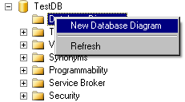
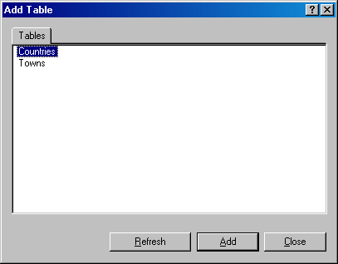
Creating an E/R diagram
In the "Database Diagrams" menu choose the "New Database Diagram" option
We can choose from the existing tables, which we want to add to the diagram

Slide 23
Database Modeling with SQL Server Management Studio
Creating Tables

Slide 24
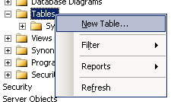
Creating Tables
If the database doesn't show immediately in Object Explorer we choose Refresh (F5)
We get a list of all the tables after we click on the “+” icon next to the name of our database and then next to Tables
To create a new table:

Slide 25
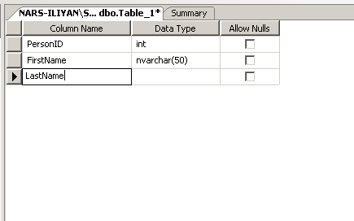
Creating Tables
To the right of Object Explorer a window is shown with the default name dbo.Table_1
We enter the name of the column here
We enter the data type of the column here
Whether NULL values can be entered

Slide 26
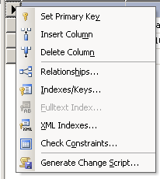
Creating Tables
Setting a primary key
Choose "Set Primary Key"
Right click here

Slide 27
Creating Tables
Setting an Identity
  Indicates that the values in a certain column are auto generated (for an
  int column)
  These values cannot be changed
  Identity Seed – the starting number from which the values in the column begin to increase.
  Identity Increment – by how much each consecutive value is increased

Slide 28
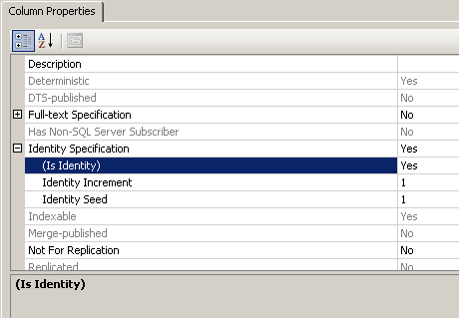
Creating Tables
Setting an Identity – by using the Column Properties window

Slide 29
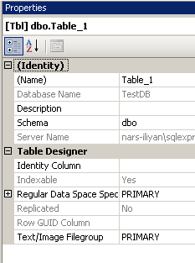
Creating Tables
It is a good practice to set the name of the table at this very moment in the Properties window
  If it's not visible – View -> Properties Window or [F4]

Slide 30
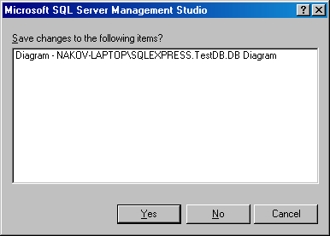
Creating Tables
When closing the window for the table, SSMSE asks whether to save the table
  You can do it manually by choosing “Save Table” from the “File” menu or by pressing Ctrl + S

Slide 31
Database Modeling with SQL Server Management Studio
Creating Relations

Slide 32
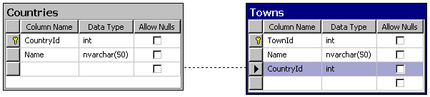
Creating Relations
We create relations one to many by dragging the foreign key column onto the other table
  We drag from the child table to the parent table

Slide 33
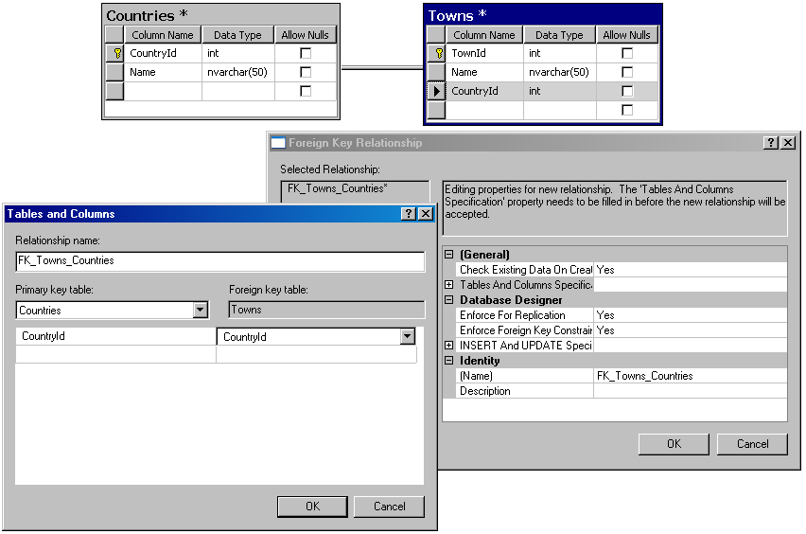
Creating Relations

Slide 34
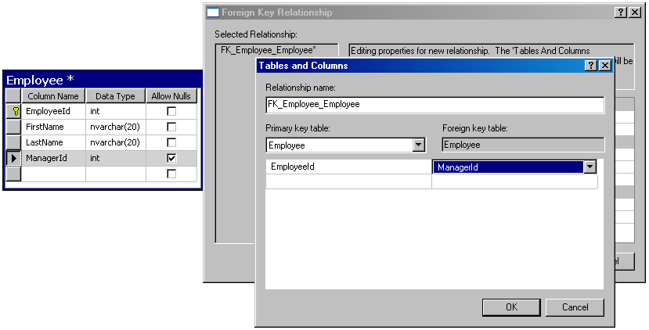
Self-relationships
Self-relationship is achieved by dragging a foreign key onto the same table

Slide 35
Database Modeling with SQL Server Management Studio
Naming Conventions

Slide 36
Naming Conventions
Tables
  Each word is capitalized (Pascal Case)
  In English, plural
  Examples: Users, AuctionGroups, Bids
Columns
  In English, singular
  Each word is capitalized (Pascal Case)
  Avoid reserved words (e.g. key)
  Examples: FirstName, OrderDate

Slide 37
Naming Conventions
Primary key
  The name of the table + "Id"
  For instance: in the Users table the PK column is called UserId
Foreign key
  The name of the reference table + Id
  For instance: in the Users table the foreign key column that references the Groups table has name GroupId

Slide 38
Naming Conventions
Relation names (constraints)
  In English, Pascal Case
  "FK_" + table1 + "_" + table2
  For example: FK_Users_Groups
Index names
  "IX_" + table + column
  For example: IX_Users_UserName

Slide 39
Naming Conventions
Unique key constraints names
  "UK_" + table + column
  For instance: UK_Users_UserName
Views names
  V_ + name
  Example: V_BGCompanies
Stored procedures names
  usp_ + name
  Example: usp_InsertCustomer(@name)

Slide 40
Database Modeling with SQL Server Management Studio
Live Demo

Slide 41
Database Design with SQL Server Management Studio
Questions?

Slide 42
Exercises
Typical universities have: faculties, departments, professors, students, courses, etc. Faculties have name and could have several departments. Each department has name, professors and courses. Each professor has name, a set of titles (Ph. D, academician, senior assistant, etc.) and a set of courses. Each course consists of several students. Each student belongs to some faculty and to several of the courses.
Your task is to create a data model diagram for the typical university using SQL Server Management Studio.

Slide 43
Exercises (2)
Fill sample data in the tables with SQL Server Management Studio.

Slide 44
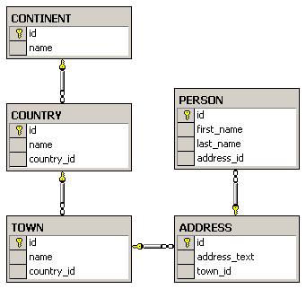
Exercises (3)
Create the following database diagram in SQL Server:

Slide 45
Exercises (4)
We should design a multilingual dictionary. We have a set of words in the dictionary.
Each word can be in some language and can have synonyms and explanations in the same language and translation words and explanations in several other languages.
The synonyms and translation words are lists of words from the dictionary. The explanations are textual descriptions.
Design a database schema (a set of tables and relationships) to store the dictionary.

